Slide 1
Information Literacy at
Sherbrooke, Québec, Canada
Eliza McKnight
Daniel Bromby

Slide 2
Bishop’s University Information Literacy and Critical Thinking (ILT)
Quick Facts about Bishop’s (founded in 1843)
Small liberal arts college (primarily undergraduate).
Roughly 110 faculty; 5 professional librarians.
One of only 3 English Universities in Québec.
History of I.L. at Bishop’s
Traditional specialized instruction sessions
1-credit Lab. ILT: Information Literacy and Critical thinking.
Key to success:
Buy-in from the professors. They are our biggest advocates!
Regular contact with academic Deans

Slide 3
Making it mandatory! Embedded since fall 2006
Departments of:
Education (+/- 110 students/year – fall semester only)
Business (+/- 150 students/year – fall &winter semesters)
Growth since…
2009: History. Modern languages
2011: Sociology, Geography?

Slide 4
Human Resources…making it work….
Workload
Teaching 3 sections (30-40 students each) at 12 hours per semester has been manageable with the appropriate support from management.
Support from management
This is a key element as certain other duties needed to been given lower priority for all this to be possible
Union issues
Ensure that instructing for-credit courses fits our job descriptions
Victims of our own success?
We must be careful not to spread ourselves too thin.

Slide 5
Evolution of IL Lab at Bishop’s
Increased Collaboration
Increased collaboration at Bishop’s has meant that Librarians are more embedded within the various departments
At the start of the program we thought we were sufficiently embedded but out of necessity and in order to remain relevant it had to become an ongoing process
Time Frame
Now taught 2hours/week for 6 weeks so that students have been exposed to content knowledge required by midterm time
Labs due by the end of class
Lecture/Demonstrate for the 1st hour of class; 2nd hour of class students complete a lab assignment

Slide 6
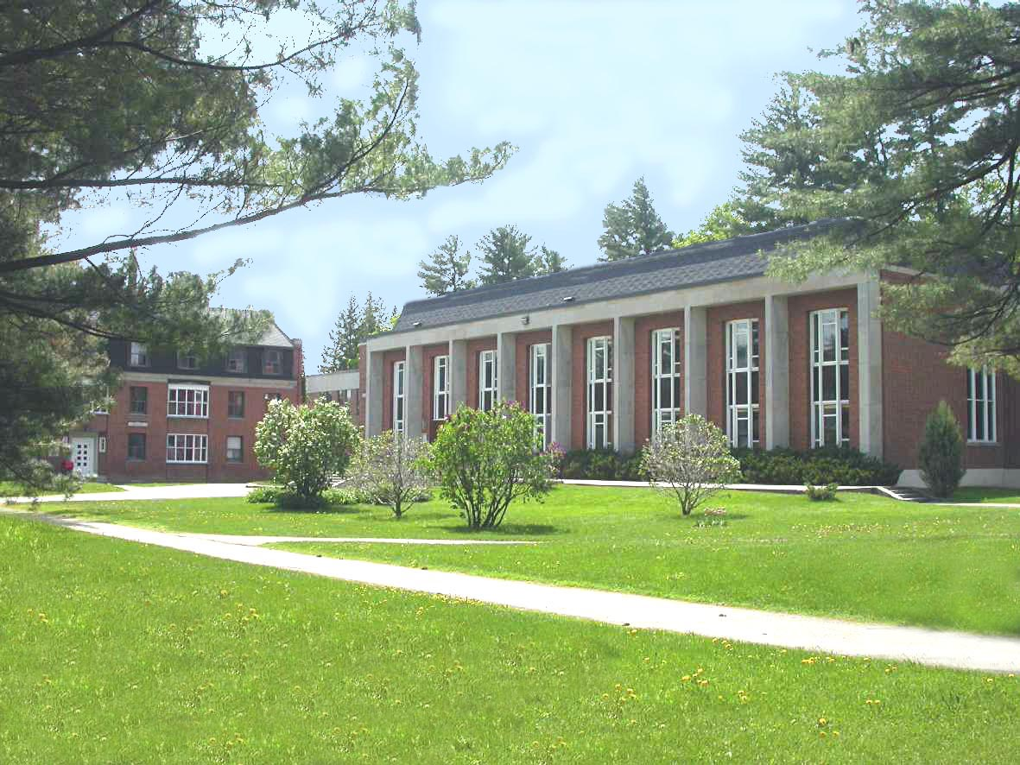
Questions?
John Bassett Memorial Library
Bishop’s University
Sherbrooke, Québec, Canada
Daniel Bromby: daniel.bromby@ubishops.ca
Eliza McKnight: eliza.mckight@ubishops.ca

